Slide 1
FLOWER ANATOMY AND REPRODUCTION

Slide 2
Parts to a Flower
Stamen-Male flower reproductive structures: anther and filament
Pistil- female part of the flower, made up of stigma, style and ovary
Stigma- the head of the pistil, looks like a sticky bulb on a long stalk in the center of a flower
Anther- part of the stamen of a flower that produces and contains pollen, usually on a stalk
Style- stalk of stigma, sits on ovary
Filament- supports the anther, long stalk-like structure
Ovary- base of the style
Contains unfertilized seeds

Slide 3
Petals and Sepals
Petals:
Modified leaves surrounding the reproductive structures of flowers
Unusually shaped or brightly colored attracting pollinators
Collectively, all the petals are called corolla
Sepals:
Leaf life structures that enclose the bud.
It protects and closes over the closed buds.
Flowers have between 2-5 sepals.
Sepals are collectively called calyx.

Slide 4
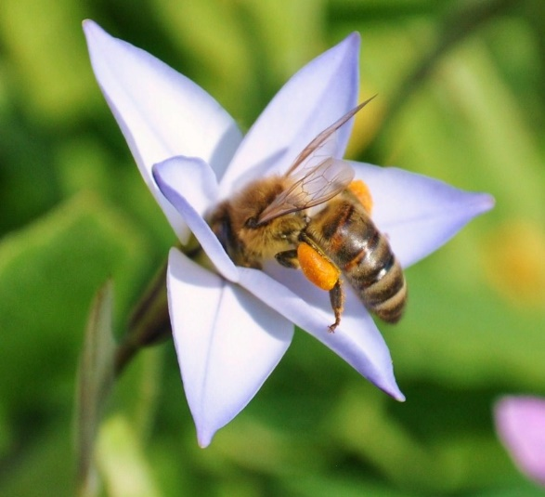
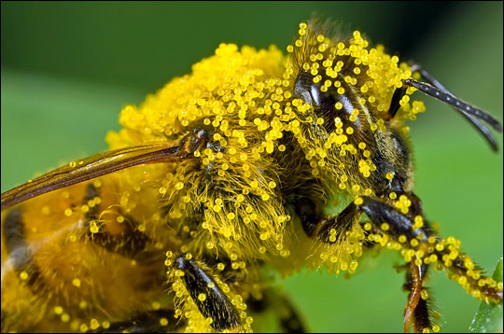
Pollination

Slide 5
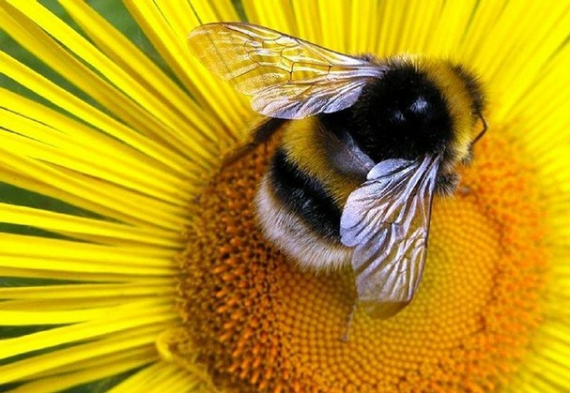
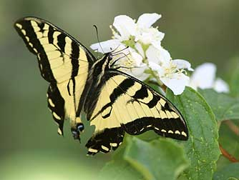
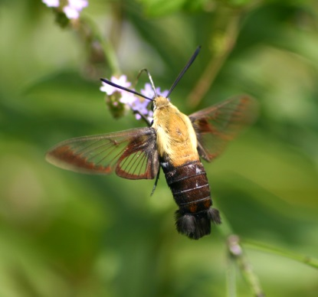
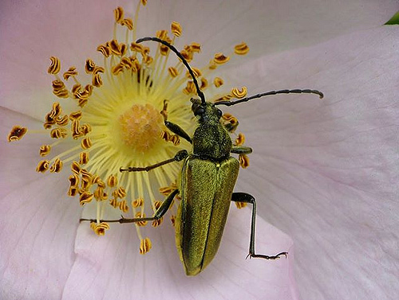
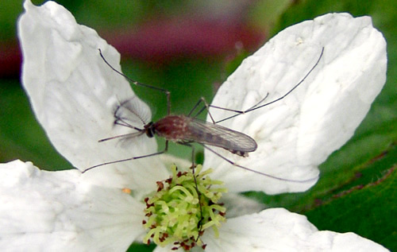
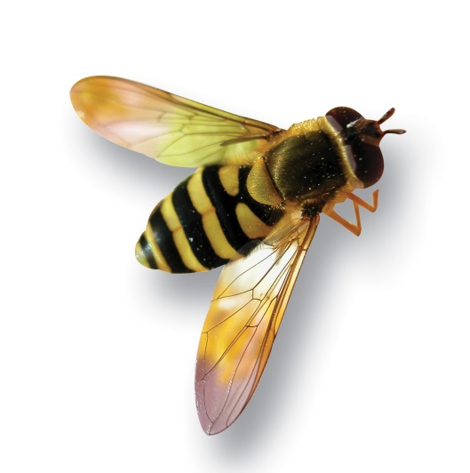
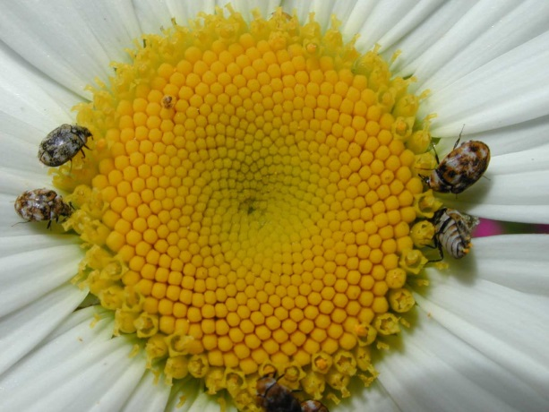
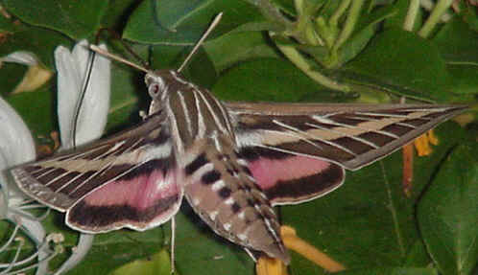
Pollinators

Slide 6
Flowering Plant Seeds
Monocotyledon (corn)
Dicotyledon ( bean)
Angiosperms- flowering plants, divided into two categories monocots, dicots
Monocots- 1 cotyledon, or seed leaf
Dicots- 2 cotyledons or seed leaves

Slide 7
Fruits
Fruits- freshy substance that surrounds the seeds. It protects the seeds and attract animals to eat them, aiding in seed dispersal

